Slide 1

PyWRIS A Python Package for India Water Resource Information System (WRIS) Data
CSE-583 Final Project
Team Members:
Ishaan Ambrish, Sanchit Minocha, Sarath Suresh, Shahzaib Khan
11 December 2024

Slide 2

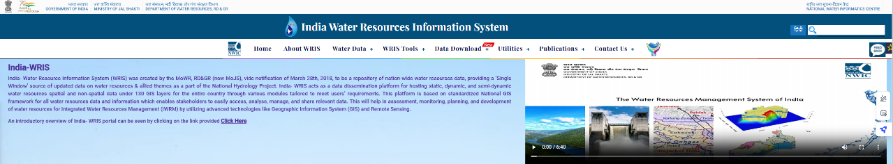
Problem Statement
India WRIS (Dept. Water Resources, Govt. of India) hosts a rich variety of Hydrological Data related to India – e.g. Reservoir, groundwater, rainfall, soil moisture data etc.
However, its GUI heavy interface is slow, not ideal for research applications.
Objective: Create a solution for accessing India WRIS data that is open-access, programmatic, fast, and scalable.

Slide 3
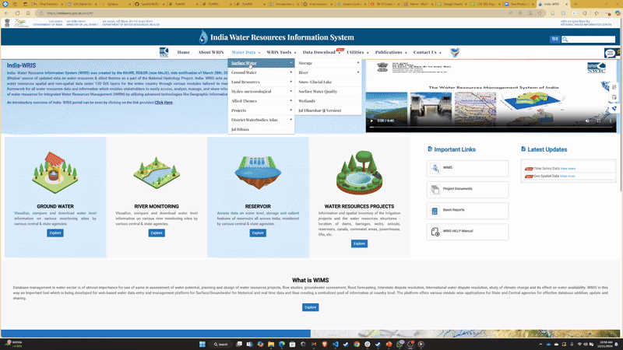
India WRIS data retrieval process for a single reservoir
https://indiawris.gov.in/wris/#/
Data retrieval time:
30s – 5mins +
India WRIS Issues:
Extremely rich, heavy GUI – slow load times
Multiple steps to access and download data – including survey form.
Not possible to automate data download for research (e.g. for daily cron jobs).

Slide 4
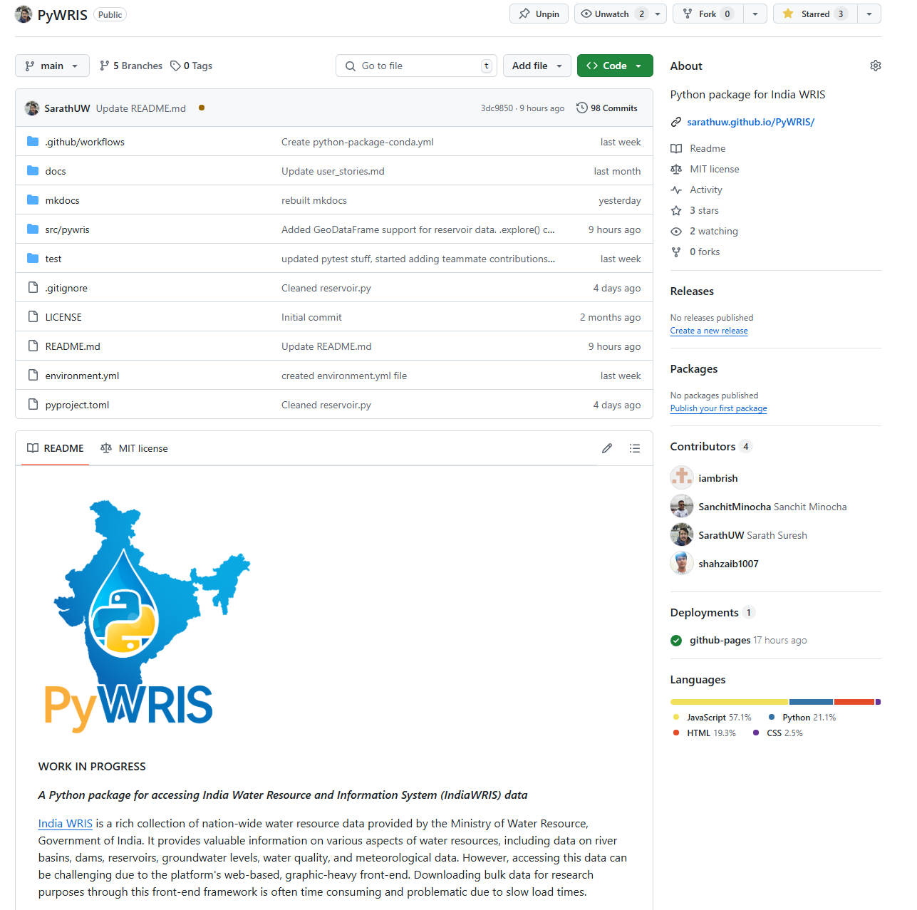
PyWRIS
https://github.com/SarathUW/PyWRIS
A python package for intuitive, fast access to India WRIS data.
Uses Web Scraping for data retrieval.
Query directly with the India WRIS database to retrieve data.
Eliminating delay caused by front-end GUI.
Optimized for Jupyter – supports rich hypertext formatting.
Easy plotting, filtering and comparison functionality.
Automated unit tests, conda deployment (under works)

Slide 5

PyWRIS
Human Centric Use Cases:
PyWRIS requires some knowledge of coding, but we will include thorough documentation
Water researchers: fetch country-wide data quickly, create interactive plots on changes over time
Agriculture professionals: predict trends for water storage over seasons, plan for water shortages
Government (water management): generate periodic reports, track real-time reservoir levels, communicate across states

Slide 6







PyWRIS -
Technologies:
Data Handling Visualisation
Documentation Jupyter Support: Rich Hypertext
Web Scraping
Requests package.
Challenges:
Structuring PyWRIS in a modular, scalable format.
India WRIS has over 20 different data products, with different types of data.

Slide 7
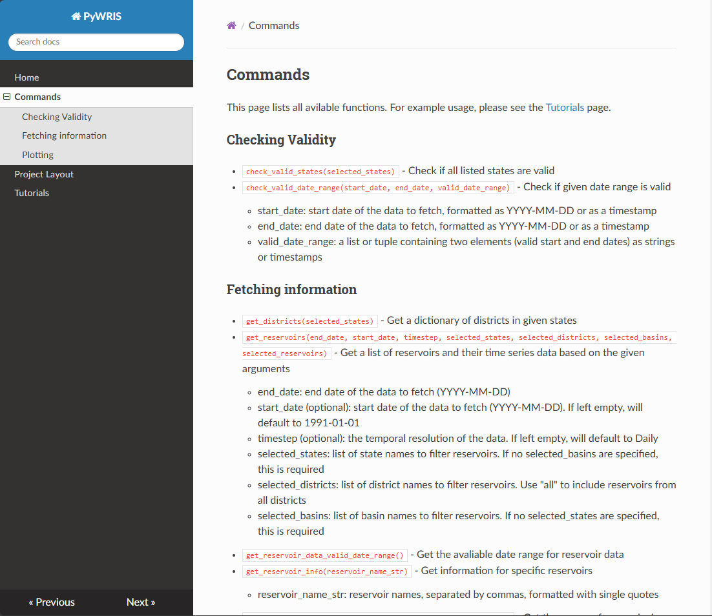
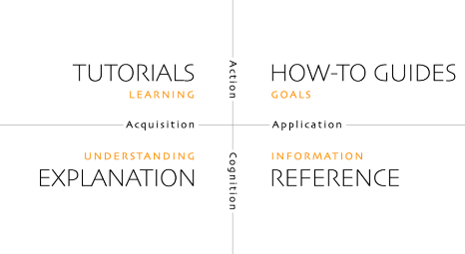
addDD
PyWRIS -
Documentation: Diátaxis framework
4 main sections:
We currently have Tutorials and Reference
Next steps: Explanation and How-to Guides

Slide 8
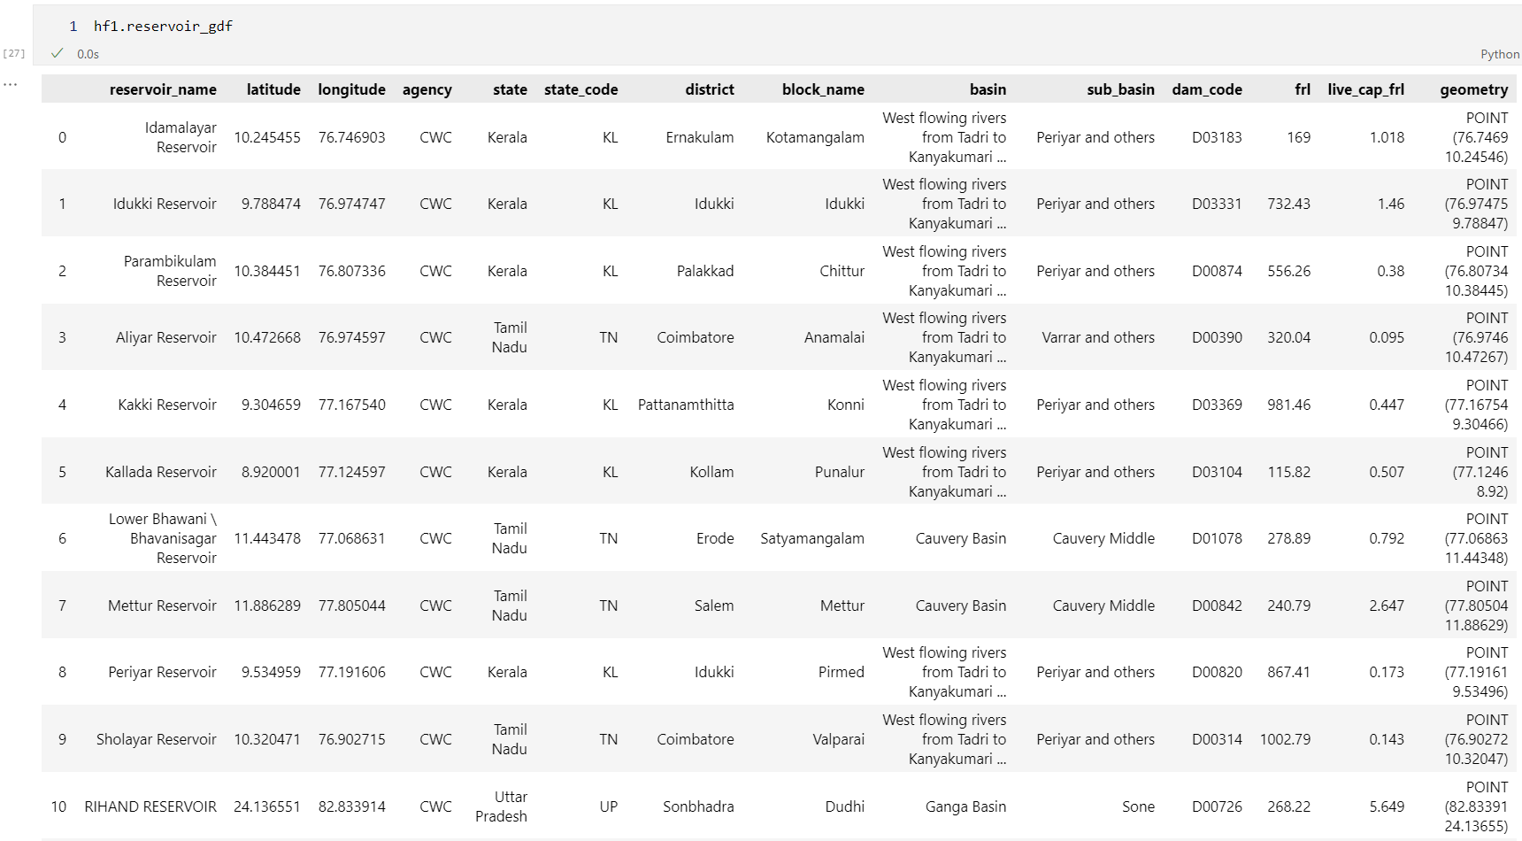
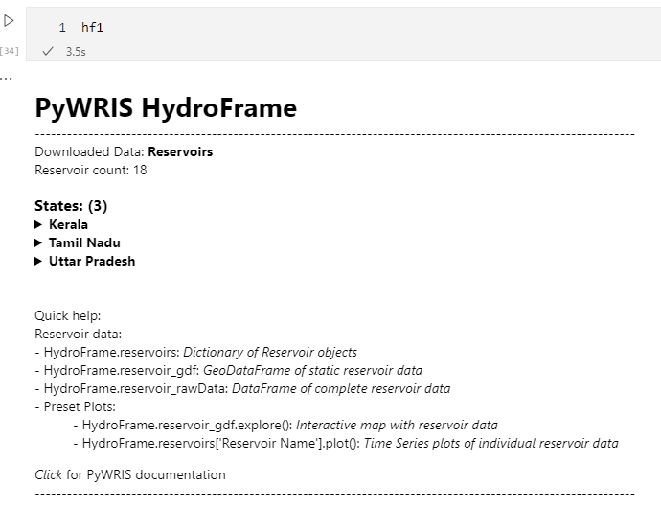

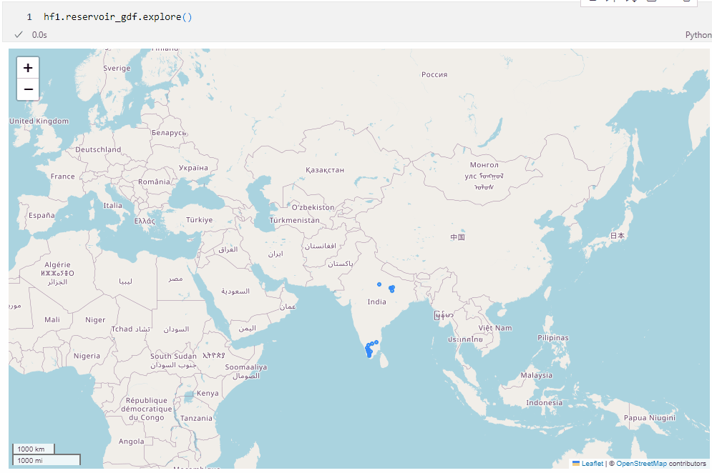
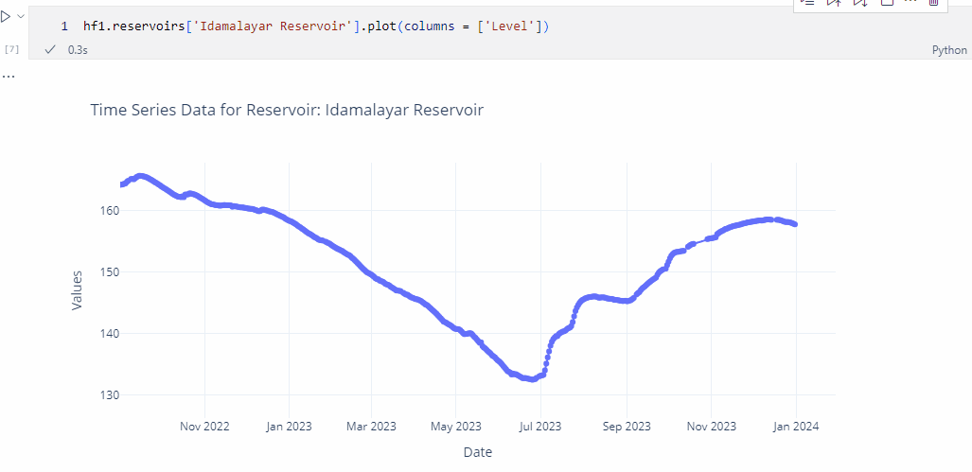

PyWRIS - Functionalities
Rich HyperText support for Jupyter
Full Data provided as DataFrames for easy analysis
Quick exploratory visualization support via
Preset Interactive plots using

Slide 9

PyWRIS
Way Forward
Add more WRIS modules: PyWRIS currently only supports Reservoir data.
Add more plotting options: More quick preset plots such as GeoSpatial scatter plots, comparison plots between station points etc.
Create Conda Package pipeline: Publishing PyWRIS package to conda-forge for easy downloads.
Add more Documentation: Keep adding to documentation website. Migrate from GitHub pages to ReadTheDocs.
Outreach - Improve Visibility, Publication Improve public visibility of PyWRIS package and aim for a publication once all modules are completed.

